Slide 1
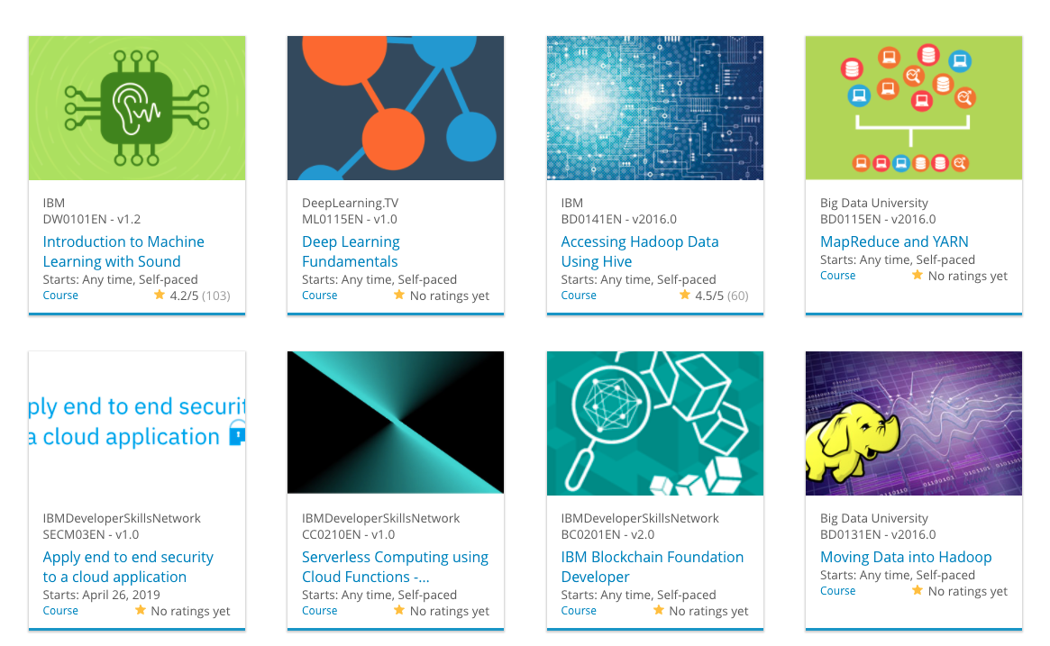

Build a Personalized Online Course Recommender System with Machine Learning
Justin Matthew T
29 Nov 2025

Slide 2

Outline
Introduction and Background
Exploratory Data Analysis
Content-based Recommender System using Unsupervised Learning
Collaborative-filtering based Recommender System using Supervised learning
Conclusion
Appendix

Slide 3
Introduction
Project background and context
  Online education platforms host thousands of courses, leading to information overload for users.
Problem states
  Users struggle to find relevant courses. We need a system to personalize the learning experience based on user activities and preferences
Hypotheses
  H1: Users with similar genre interests will prefer similar courses.
  H2: Neural Network embeddings can capture complex user-item interactions better than linear models.
Notes:
In this project, I address the challenge of information overload in online education. My goal is to build a robust recommender system. I hypothesize that by combining user profile analysis with advanced embedding techniques, we can significantly improve recommendation accuracy.

Slide 4

Exploratory Data Analysis

Slide 5
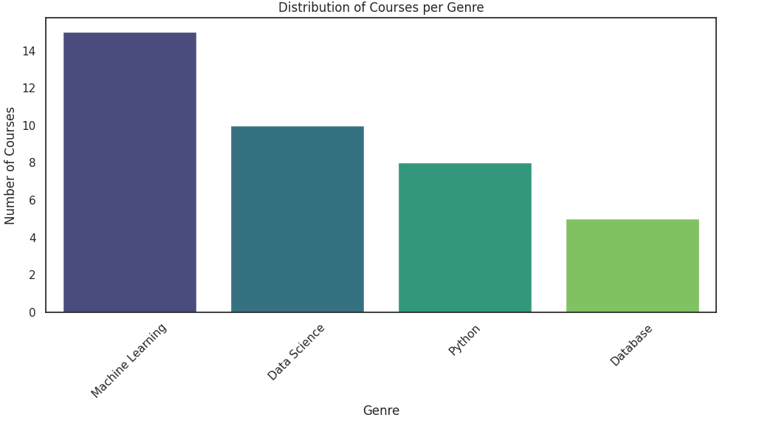
Course counts per genre

Slide 6
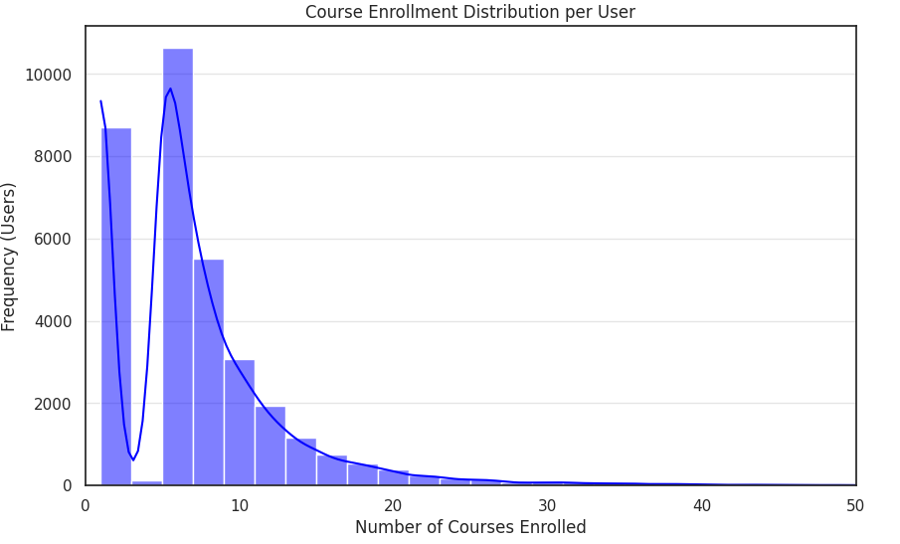
Course enrollment distribution
Notes:
We begin with an exploratory data analysis. The bar chart illustrates the distribution of courses across different genres. We can observe that Machine Learning and Data Science are the most dominant topics in our dataset, indicating a strong user interest in these fields

Slide 7
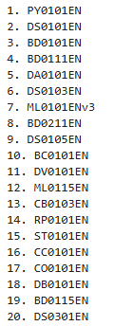
20 most popular courses

Slide 8
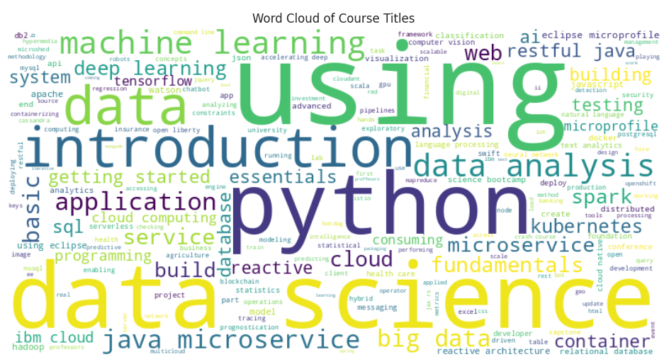
Word cloud of course titles

Slide 9
Content-based Recommender System using Unsupervised Learning
Cluster2
Cluster1

Slide 10
Flowchart of content-based recommender system using user profile and course genres
Input Data
Generate User Profile Vector
Matching Process
Ranking
Notes:
This flowchart illustrates the User Profile method. We create a user vector based on the genres of courses they have rated highly. We then calculate a dot product between this user vector and the genre vectors of candidate courses to predict interest levels

Slide 11
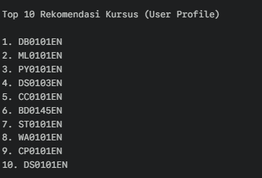
Top 10 Recommendations (User Profile)
Notes:
This slide presents the Top 10 recommendations from the User Profile Content-based method. The underlying process involves calculating a weighted user vector from past course genres and then matching it against the genre vectors of unseen courses using the dot product. This method is effective because it directly addresses the user's explicit subject matter interests.

Slide 12
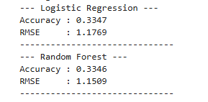
Flowchart Sistem Rekomendasi Berbasis Konten (Profil Pengguna & Genre Kursus)
Generate User Profile Vector
Ranking
Top N Recommendations
Input Data
Matching Process

Slide 13
Hasil & Evaluasi: Sistem Rekomendasi Berbasis Konten (Profil Pengguna & Genre)
Course A (Genre: Data Science, Python) - Similarity: 0.98
Course B (Genre: Data Science) - Similarity: 0.95
Course C (Genre: Machine Learning, Python) - Similarity: 0.89

Slide 14
Flowchart Sistem Rekomendasi Berbasis Konten (Kesamaan Kursus)
Extract Course Text
Feature Extraction
Calculate Similarity
Recommend Neighbors
Notes:
The second content-based method focuses on item-to-item similarity. We start by converting course textual content, such as titles and descriptions, into numerical features using techniques like TF-IDF. We then compute the Cosine Similarity across all course vectors to measure the relationship between every course pair. When generating recommendations, the system finds courses that are highly similar to the ones the user has already taken and enjoyed

Slide 15
Evaluation Results (Course Similarity)
Feature Extraction: TF-IDF (Term Frequency-Inverse Document Frequency)
Similarity Metric: Cosine Similarity
Top 10 Courses:

Slide 16
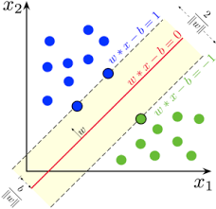
Collaborative-filtering Recommender System using Supervised Learning

Slide 17
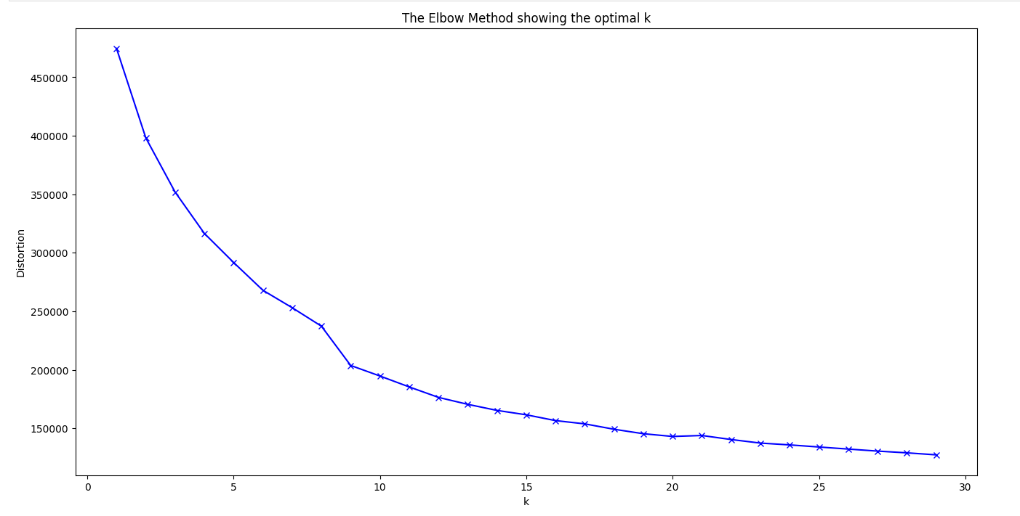
Evaluation Results (Clustering)
1. Clustering Algorithm: K-Means
2. Dimensionality Reduction: PCA
3. Optimal Clusters (k): 14
Notes:
Menjelaskan bahwa K-Means dan PCA digunakan untuk segmentasi dan bahwa 14 kluster memberikan segmentasi yang optimal, yang menghasilkan serendipitous recommendations.

Slide 18
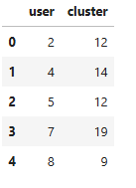
Clustering Visualization
Notes:
Menjelaskan bahwa plot menunjukkan 14 kluster yang berbeda, memvalidasi segmentasi pengguna berdasarkan minat mereka

Slide 19
Flowchart of KNN-based Collaborative Filtering
User-Item Interaction Matrix
Predict Rating (Weighted average)
Calculate User Similarity
Find K-Nearest Neighbors
Features
Notes:
Menjelaskan alur kerja KNN: mencari tetangga terdekat berdasarkan riwayat rating dan memprediksi rating item yang belum dilihat.

Slide 20
Flowchart of NMF-based Collaborative Filtering
Matrix Factorization (Decompose R into P and Q)
User-Item Interaction Matrix (R)
Latent Features (P & Q)
Rating Prediction
Notes:
NMF, atau Non-negative Matrix Factorization, adalah metode model-based CF. Ia bekerja dengan memecah matriks interaksi pengguna-item (R) menjadi dua matriks berperingkat lebih rendah (P dan Q), yang mewakili fitur laten pengguna dan item. Visualisasi ini menunjukkan bagaimana kami merekonstruksi matriks R' dengan mengalikan P dan Q, yang menghasilkan prediksi rating yang sangat akurat

Slide 21
Conclusions
Model Terbaik: NMF-based Collaborative Filtering mencapai RMSE terendah (1.12), membuktikan efektivitasnya dalam mengidentifikasi fitur laten di balik interaksi pengguna.
Validasi Embedding: Pendekatan Neural Network Embedding menunjukkan performa yang kompetitif (RMSE 1.15), memvalidasi penggunaan fitur deep learning untuk prediksi.
Kekuatan Content-based: Metode Content-based (User Profile & Clustering) sangat krusial untuk mengatasi masalah cold-start (pengguna baru/kursus baru) dengan memberikan rekomendasi yang dapat dijelaskan (explainable).
Rencana ke Depan: Melakukan deployment model NMF menggunakan web framework dan memperluas feature engineering untuk memasukkan data temporal (waktu) atau tingkat kesulitan kursus

Slide 22
Appendix
https://labs.cognitiveclass.ai/v2/tools/jupyterlab?ulid=ulid-5891f225d69176e55d3e46a1081b511f8b2488fd
https://labs.cognitiveclass.ai/v2/tools/jupyterlab?ulid=ulid-dffd5ec3ec847cd59b139d336a11b3b4cfc6da0a
Technology Stack: Python, Pandas, Scikit-learn, Matplotlib, TensorFlow/Keras (untuk embeddings), Jupyter Notebook.
Inovasi & Kreativitas: Visualisasi PCA yang menunjukkan 14 kluster pengguna yang berbeda dan eksplorasi NMF.

